Slide 1
Lecture 7: The ElGamal Cryptosystem and Discrete Logarithms -Cryptographic Algorithms and Protocols
Huang, Xiujie (黄秀姐)
Office: Nanhai Building, #411
E-mail: t_xiujie@jnu.edu.cn
Dept. Computer Science

Slide 2
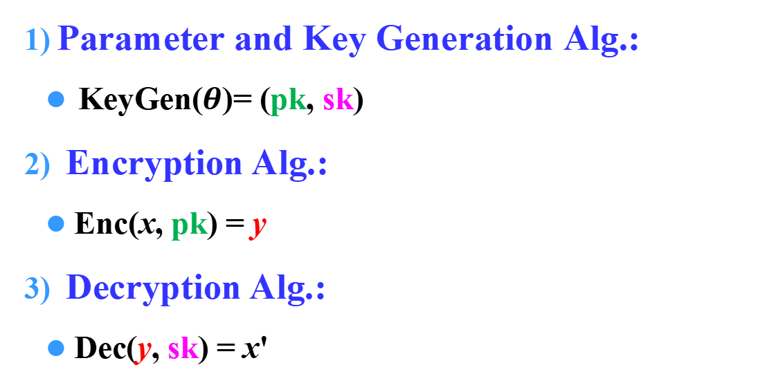
Review
Public-key Cryptography (PKC)
Parameter and Key Generation Alg.:
KeyGen($θ$)= (pk, sk)
Encryption Alg.:
Enc(x, pk) = y
Decryption Alg.:
Dec(y, sk) = x'
Alice
Bob
Bob’s pk
Bob’s sk

Slide 3
Review
Public-key Cryptography (PKC)
1. RSA

Slide 4
RSA Cryptosystem, 1977
Key Generation:
Generate two large odd primes p and q such that p ≠ q
Compute n = pq and ϕ(n) = (p-1)(q-1)
Choose a random number b (1 < b < ϕ(n)) such that gcd(b, ϕ(n))=1
Compute a ≡ b ⁻¹ (mod ϕ(n))
Output: pk = (n, b), sk = (p, q, a)
Encryption: e_{pk}(x) = x^{b} mod n
Decryption: d_{sk}(y) = yª mod n

Slide 5
Review
Public-key Cryptography (PKC)
1. RSA ←→ Factoring Integers
2. ElGamal ←→ Discrete Logarithm
Others ???

Slide 6
Outline
1. The ElGamal Cryptosystem
Discrete Logarithm Problem (DLP)
The ElGamal Cryptosystem
2. Algorithms for the DLP
Shanks’ Algorithm
3. Suitable Groups for the DLP
Finite Fields & Elliptic Curves
Suitable Groups for the DLP
4. Security of ElGamal Systems
Bit Security and Semantic Security
The Diffie-Hellman Problems

Slide 7
The Finite Group
Let G be a finite multiplicative group (乘法群)
Order of the group G, denoted by |G|: the number of elements in G
Order of an element g in G: the smallest positive integer m such that g^{m} = 1
Cyclic Group G: if there exists an element g in G such that the order of g is |G|. Such g is called a primitive element, and G can be represented as
G = {g¹, g²,…, g^{|G|-1} , g^{|G|}=1}=<g>
Examples: Z₄ ={0, 1, 2, 3} is not a multiplicative group
Z₄*={1,3}, ord(1)=1, ord(3)=2;
Z₅*={1,2,3,4}, ord(1)=1, ord(2)=4, ord(3)=4, ord(4)=2;
Z₅* =<2> = <3>: 3¹ (mod5) =3, 3² (mod5)=4, 3³ (mod5) =2, 3⁴ (mod5) =1

Slide 8



The Finite Group
Finite multiplicative group (G, ·)
Cyclic subgroup
G = , p is prime
= G since G = is a cyclic group.
= b^{(p-1)/q} , where b is the primitive of element in G, i.e.,
q
Examples:
Z₅*={1,2,3,4}. ord(1)=1, ord(2)=4, ord(3)=4, ord(4)=2.
Z₅* = < 2 > = < 3 >; < 4 > = {1, 4}
Z₁₃*={1,2,3,……, 11, 12}. < 2 > = Z₁₃* (2⁵≡6 (mod 13), 2¹¹≡7 (mod 13), 2¹²≡1 (mod 13) ); < 5 > ={1,5, 8,12} (5²≡12 (mod 13), 5³≡8 (mod 13), 5⁴≡1 (mod 13)).

Slide 9
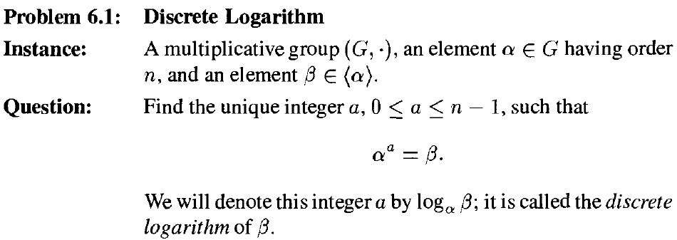
The Discrete Logarithm Problem (DLP)
7.1:
a = log_{α} β
Exponentiation is a one-way function in suitable groups G.
Operation of exponentiation is computable: Algorithm 6.5
Finding a is (probably) difficult

Slide 10
The ElGamal Cryptosystem, 1985
Set-up of Key Generation:
Generate a large prime p such that the DLP in Z_{p}* is infeasible
Choose a primitive element α∈Z_{p}*
Choose a random number a and Compute β ≡ α ª (mod p)
Output: pk = (p, α, β), sk = (a)
Randomized:
one plaintext, p-1 ciphertexts
Encryption:
Choose a secret random number k in Z_{p-1}
Compute e_{pk}(x) = (y₁, y₂) where y₁ = α^{k} mod p and y₂ = xβ^{k} mod p
Decryption:
Compute d_{sk}(y₁, y₂) = y₂(y₁ª)⁻¹ mod p
Correctness: d_{sk}(y₁, y₂) = x?
d_{sk}(y₁, y₂) = y₂(y₁ª)⁻¹
= xβ^{k} ((α^{k} )ª)⁻¹ = xβ^{k} ((αª )^{k})⁻¹
= xβ^{k} (β)^{k})⁻¹ = x
Cryptosystem 7.1, P257
Notes:
X is masked by multiplying it by \beta_k, yielding y_2.

Slide 11
Example 1
p = 13, α = 2, a = 5, β = 2⁵ mod 13 = 6
pk = (13, 2, 6), sk = (5)
Encryption of x = 10
Choose a secret random number k = 7 in Z_{p-1}
Compute e_{pk}(x) = (y₁, y₂) where y₁ = α^{k} mod p = 2⁷ mod 13 = 11,
and y₂ = xβ^{k} mod p = 10∙6⁷ mod 13 = 5.
Decryption
Compute d_{sk}(y₁, y₂) = y₂(y₁ª)⁻¹ mod p = 5 ∙ (11⁵)⁻¹ mod 13
= 5 ∙ (7)⁻¹ mod 13 = 5 ∙ 2 mod 13 = 10.

Slide 12






Example 2
7.1:
Case 1: x = 1299, k = 853
:
Case 2: x = 1299, k = 1000？

Slide 13
The ElGamal Cryptosystem, 1985
Set-up of Key Generation:
Generate a large prime p such that the DLP in Z_{p}* is infeasible
Choose a primitive element α∈Z_{p}*
Choose a random number a and Compute β ≡ α ª (mod p)
Output: pk = (p, α, β), sk = (a)
Encryption:
Choose a secret random number k in Z_{p-1}
Compute e_{pk}(x) = (y₁, y₂) where y₁ = α^{k} mod p and y₂ = xβ^{k} mod p
Decryption:
Compute d_{sk}(y₁, y₂) = y₂(y₁ª)⁻¹ mod p
Cryptosystem 7.1, P257
Notes:
X is masked by multiplying it by \beta_k, yielding y_2.

Slide 14
Choices of Large Prime p
A necessary condition to be secure:
the Discrete Logarithm problem in is infeasible, i.e., there is no known polynomial-time algorithm to solve DLP
p should have at least 2048 bits
p-1 should have at least one “large” prime factor

Slide 15
Outline
1. The ElGamal Cryptosystem
Discrete Logarithm Problem (DLP)
The ElGamal Cryptosystem
2. Algorithms for the DLP
Shanks’ Algorithm
3. Suitable Groups for the DLP
Finite Fields & Elliptic Curves
Suitable Groups for the DLP
4. Security of ElGamal Systems
Bit Security and Semantic Security
The Diffie-Hellman Problems

Slide 16
DLP
7.1:
a = log_{α} β

Slide 17
Algorithms for DLP
An assumption: computing the product of two elements requires constant (i.e., O(1)) time.
Some trivial algorithms:
1) Exhaustive search: O(n) time, O(1) memory
2) Precomputing → sorting → searching:
O(n) time; O(n log n) time; O(log n) time; O(n) memory

Slide 18
Algorithms for DLP
Some non-trivial algorithms:
1. Shanks’ Alogrithm
2. The Pollard Rho Discrete Logarithm Algorithm
3. The Pohig-Hellman Algorithm
4. The Index Calculus Method (for only)
Generic algorithm:
if the algorithm for the DLP can be applied in any group.
1, 2, and 3 are generic algorithms, while 4 is not.

Slide 19
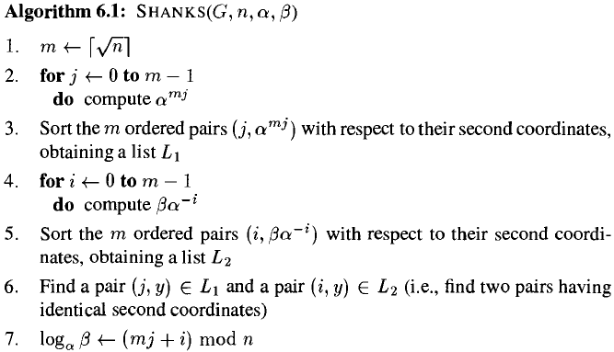
Shanks’ Algorithm for DLP
An assumption: computing the product of two elements requires constant (i.e., O(1)) time.
7.1:
--O(m) time, O(m) memory
--O(m log(m)) time, O(m) memory
--O(m) time, O(m) memory
--O(m log(m)) time, O (m) memory
--O (m) time, O (m) memory

Slide 20
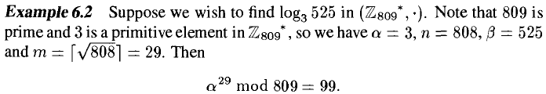
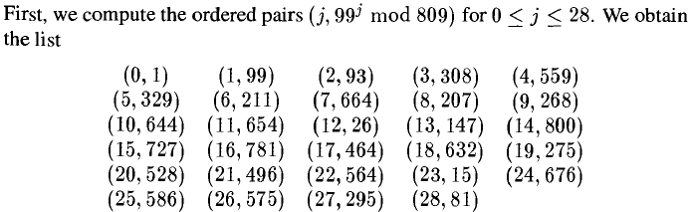
An Example of Shanks’ Algorithm
7.2:
precompute α^{m} mod p:
(j, α^{mj} mod p)

Slide 21
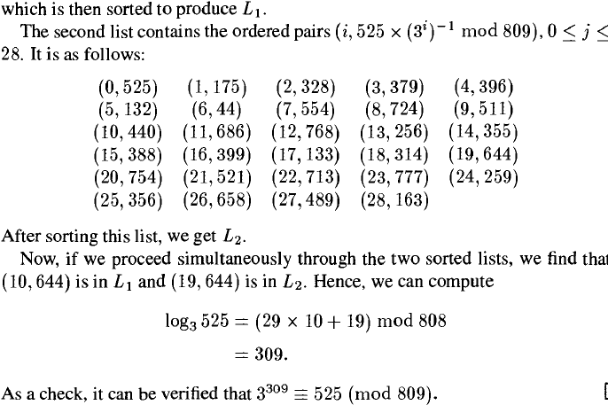
An Example of Shanks’ Algorithm
Example 7.2
(i, βα^{-i} mod p)
a = log_{α} β = (mj +i) mod n

Slide 22
Outline
1. The ElGamal Cryptosystem
Discrete Logarithm Problem (DLP)
The ElGamal Cryptosystem
2. Algorithms for the DLP
Shanks’ Algorithm
3. Suitable Groups for the DLP
Finite Fields & Elliptic Curves
Suitable Groups for the DLP
4. Security of ElGamal Systems
Bit Security and Semantic Security
The Diffie-Hellman Problems

Slide 23
Suitable Groups for ElGamal Crypt
The ElGamal Cryptosystem can be implemented in any group where the DLP is infeasible
, p is a large prime
1. the multiplicative group of the Finite Field , p is prime
2. the group of an Elliptic Curve defined over a finite field

Slide 24
Finite Field
( , +, ·), p is prime
( , +, ·), p is prime

Slide 25
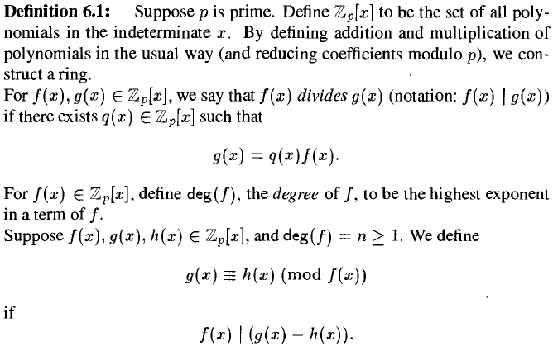
Construction of Finite Field
Congruence of polynomials
7.1:

Slide 26
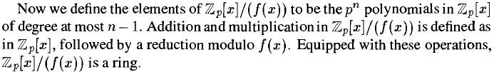

Construction of Finite Field
Quotient Ring: = {g(x) mod f(x): g(x) is in }
= {a_{n-1} x^{n-1} + … + a₂ x² + a₁x + a₀: a_{i} in }

Slide 27
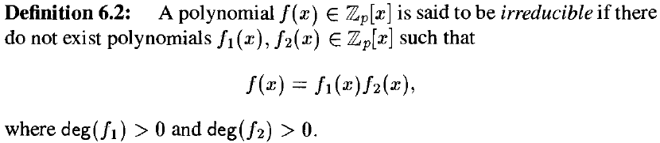

Construction of Finite Field
Irreducible polynomial
7.2:
Existence and Uniqueness:
Existence for the irreducible poly. of any n
Isomorphism of any two finite fields with same p and n

Slide 28
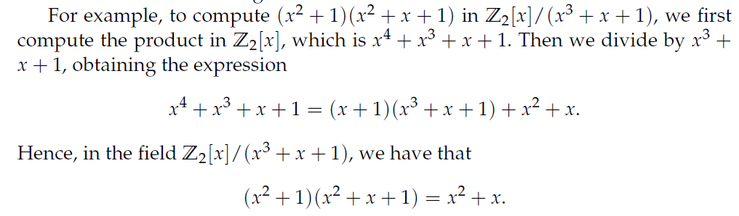
Example of the Finite Field
Order: 2^{n}
Z₂[x]/(f(x)): f(x) is irreducible and deg(f) = n
a_{n-1} x^{n-1} + … + a₂ x² + a₁x + a₀
←→ (a_{n-1} … a₂ a₁a₀)
See Example on Pages 273-274
Extended Euclidean Alg. for Polynomials

Slide 29
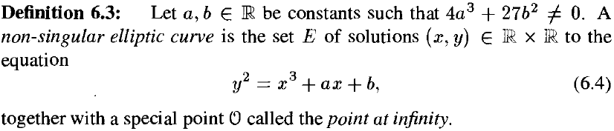

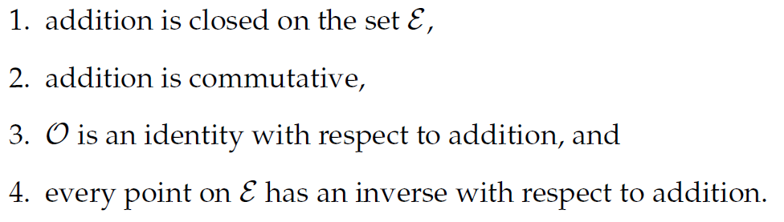
Elliptic Curves (椭圆曲线)
Elliptic Curves over the Reals
7.3:
is an abelian addition group
P+Q=R
5. addition is associative

Slide 30
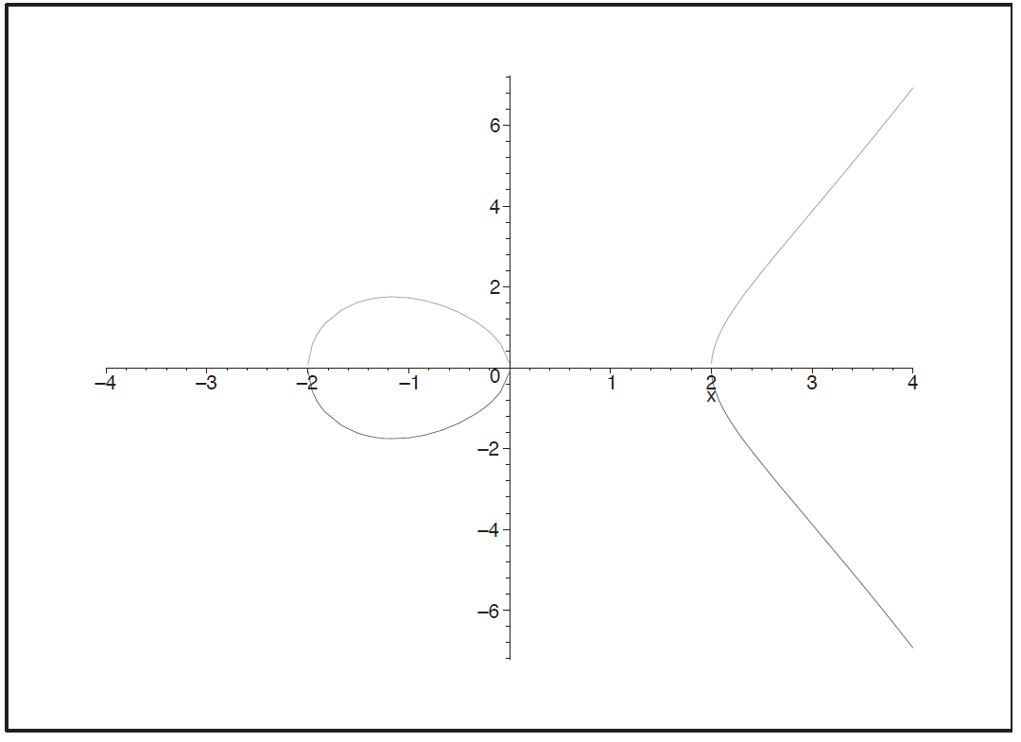
Elliptic Curves
Elliptic Curves over the Reals
Example:
Q
P
2P
R
P+Q=R
P+Q=O

Slide 31
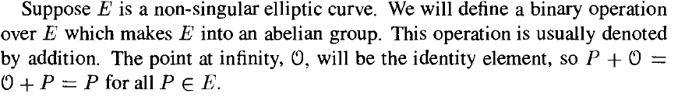

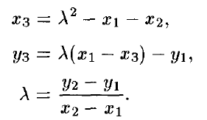




Elliptic Curves
Elliptic Curves over the Reals
Abelian group

Slide 32

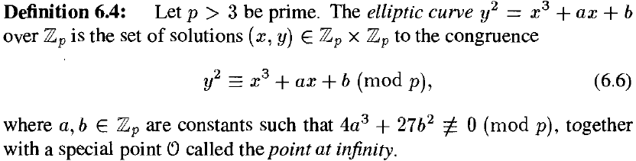



Elliptic Curves Modulo a Prime
Elliptic Curves over , where p > 3 is prime
7.4:
else:

Slide 33

Elliptic Curves (椭圆曲线)
1. Elliptic Curves over the Reals
2. Elliptic Curves over , where p > 3 is prime
Example7.9
3. Elliptic Curves over Finite Fields
Example 7.10

Slide 34


Elliptic Curves
4. Properties of Elliptic Curves over
Hasse asserts:
Schoof’s algorithm: to compute efficiently

Slide 35
Elliptic Curves
5. Elliptic Curve Discrete Logarithm Problem (ECDLP)
ECDLP:
Given P, Q ∈ G (where Q = mP).
Find m.
An elliptic curve having a cyclic subgroup G of size about 2²²⁴ will provide a secure setting for a cryptosystem, provided that #G is divisible by at least one large prime factor.
The ECDLP is hard to be solved

Slide 36
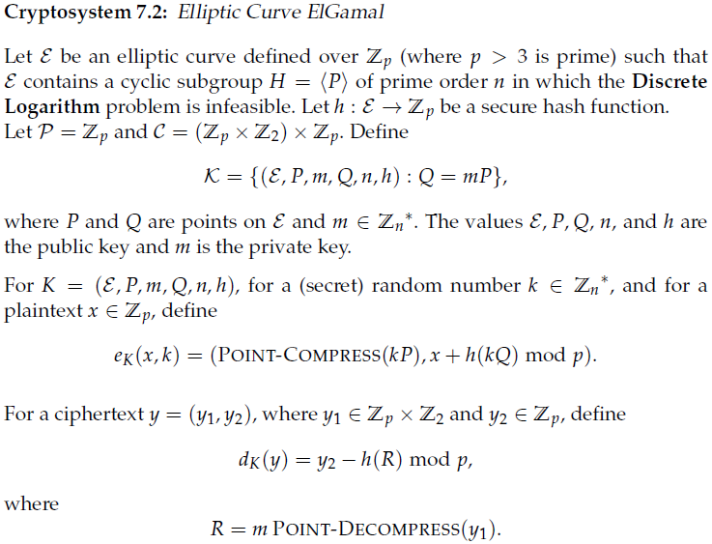
Elliptic Curves
6.ElGamal Cryptosystems on Elliptic Curves
EC-ElGamal Crypt:
KeyGen(θ): pk = (ε, P, Q, n, h), sk = (m);
Enc_{pk}(x)=(y₁, y₂): first choose k randomly,
then compute y₁ = kP, y₂ = x+h(kQ) mod p;
Dec_{sk}(y₁, y₂) = y₂ - h(my₁) mod p.
Correctness: R = my₁ =mkP = kQ.

Slide 37
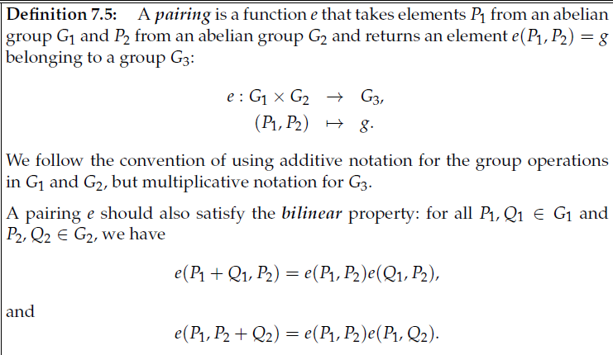

Elliptic Curves
7. Pairings on Elliptic Curves
First used in Cryptography by Menezes, Okamoto and Vanstone for solving ECDLP
widely used in identity-based cryptosystems

Slide 38
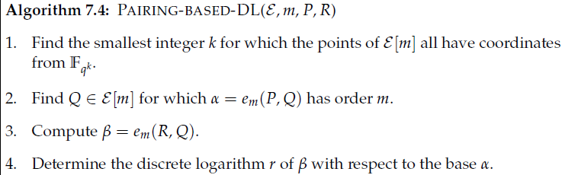



Elliptic Curves
7. Pairings on Elliptic Curves
Paring-based DLP (Skipped)
：
for proper choices of m and q

Slide 39
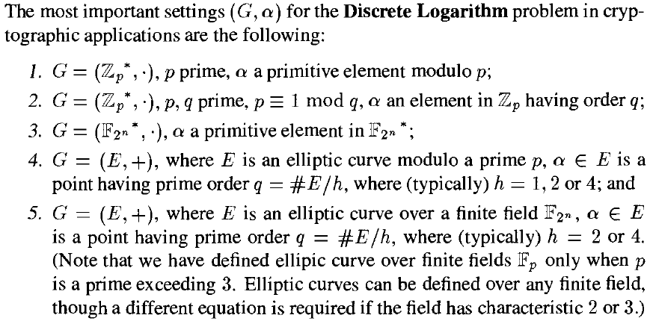
Suitable Groups of the “Difficult” DLP
p > 2²⁰⁴⁸
p > 2²⁰⁴⁸
q > 2²²⁴
p > 2²²⁴
n ≈ 224

Slide 40
Outline
1. The ElGamal Cryptosystem
Discrete Logarithm Problem (DLP)
The ElGamal Cryptosystem
2. Algorithms for the DLP
Shanks’ Algorithm
3. Suitable Groups for the DLP
Finite Fields & Elliptic Curves
Suitable Groups for the DLP
4. Security of ElGamal Systems
Bit Security and Semantic Security
The Diffie-Hellman Problems

Slide 41
Different Attack Goals
Total Break: to know the private key or the secret key
Partial Break: be able to decrypt a previously unseen ciphertext without the key, or to determine some specific information about the plaintext given the ciphertext, with non-negligible probability
Distinguishability of Ciphertexts: be able to distinguish between encryptions of two given plaintexts, or between an encryption of a given plaintext and a random string, with probability exceeding 1/2
Notes:
A List of Potential adversarial goals:

Slide 42
Security (against Total Break)
Security (Choice of proper p)
based on that the Discrete Logarithm problem in is infeasible, i.e., there is no polynomial-time algorithm to solve DLP
p should have at least 2048 bits
p-1 should have at least one large prime factor
The secret key a and the random number k used in encryption can not be small
The random number k is used once and changed for a new encryption

Slide 43
Misuse of the secret k
If the same k is used for two encryptions:
Choose a secret random number k in Z_{p-1}
Encrypt 1: e_{pk}(x₁) = (y₁, y₂) where y₁ = α^{k} mod p and y₂ = x₁β^{k} mod p
Encrypt 2: e_{pk}(x₂) = (z₁, z₂) where z₁ = α^{k} mod p and z₂ = x₂β^{k} mod p
z₂/y₂ = x₂/x₁
If the plaintext x₁ is known (for example, under the known plaintext attack), then it is easy to obtain x₂.
Notes:
X is masked by multiplying it by \beta_k, yielding y_2.

Slide 44
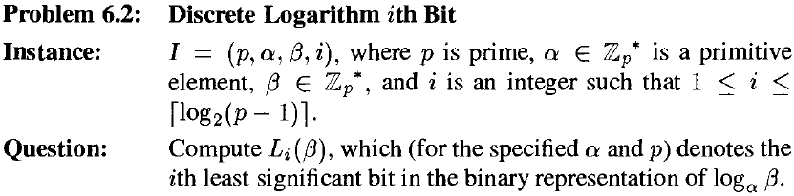



Bit Security (against Partial Break)
Computing the least significant bit of a DL is easy.
Computing (where , and t is odd) is easy.
Computing is (probably) difficult.
Suppose s=1 since p-1 should have at least one large prime factor.
So L₂(β) is difficult to obtain, while L₁(β) is easy to compute.

Slide 45
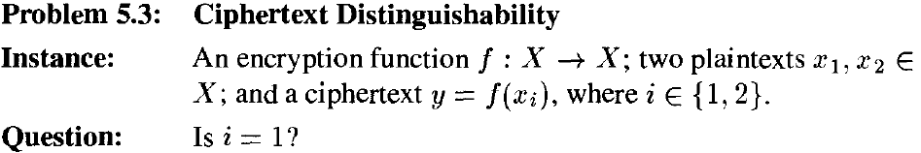
Semantic Security
A cryptosystem is said to achieve semantic security if the cryptosystem satisfies that the adversary cannot (in polynomial time) distinguish ciphertexts.
6.3:

Slide 46
Semantic Security of ElGamals
The basic ElGamal Cryptosystem, as described in Cryptosystem 7.1, is not semantically secure.
By the properties of the quadratic residuosity and Euler’s criterion
x₁ is a quadratic residue modulo p, i.e., x₁ is in
x₂ is a quadratic non-residue modulo p
(y₁, y₂) is an encryption of x₁ iff β^{k} and y₂ are both quadratic residues or both quadratic non-residues (i.e., L₁(β^{k}) = 0 and L₁(y₂) = 0, or L₁(β^{k}) = 1 and L₁(y₂) = 1, which are easy to compute).
A variant of the ElGamal Cryptosystem is conjectured to be semantically secure if the DLP in QR(p) ⸦ Z_{p}* is infeasible
Over the subgroup (cyclic, of order q) of quadratic residues modulo p and p=2q+1 where p and q are prime

Slide 47
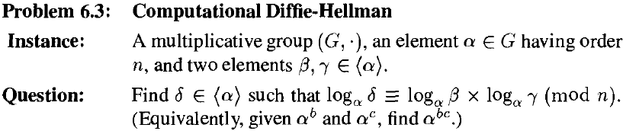
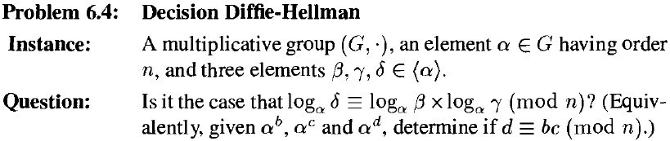
The Diffie-Hellman Problems
Connection with Diffie-Hellman key agreement protocols in Section 12.2
CDH
DDH

Slide 48

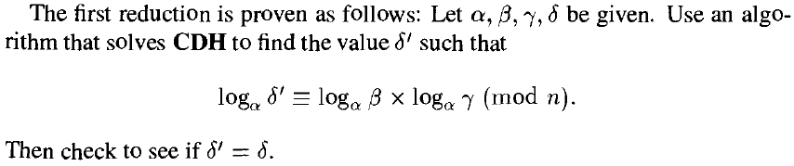


Reductions of DHPs
orcale
orcale
difficulty of solving DDH ≤ difficulty of solving CDH ≤ difficulty of solving DL

Slide 49
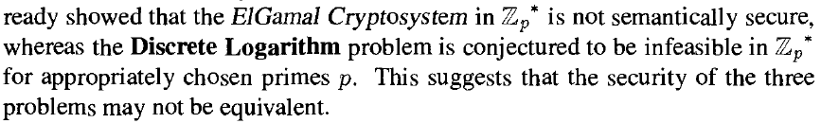
Security of DHPs
The security of DDH, CDH, DL may not be equivalent.
semantic security of the ElGamal Crypt ←→ infeasibility of DDH
ElGamal decryption←→solving CDH
necessary assumption to prove the security of the ElGamal Crypt is stronger than the infeasibility of DL
See Ex7.23
See next slide

Slide 50
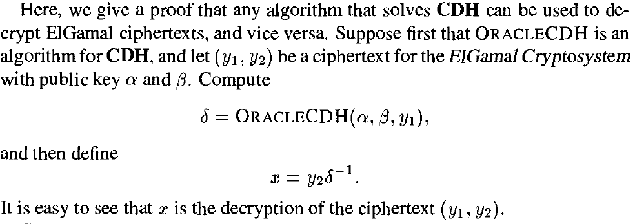
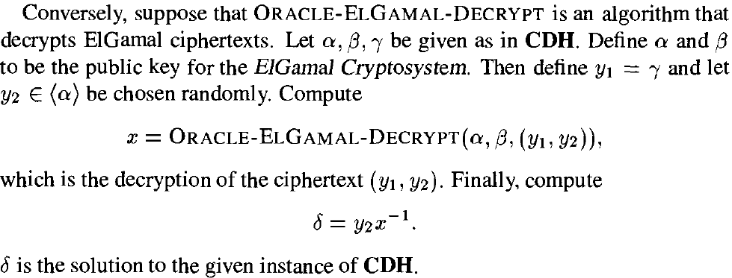
ElGamal decryption CDH
ElG Dec ∝_{T} CDH
CDH ∝_{T} ElG Dec

Slide 51
Summary
1. The ElGamal Cryptosystem
Discrete Logarithm Problem (DLP)
The ElGamal Cryptosystem
2. Algorithms for the DLP
Shanks’ Algorithm
3. Suitable Groups for the DLP
Finite Fields & Elliptic Curves
Suitable Groups for the DLP
4. Security of ElGamal Systems
Bit Security and Semantic Security
The Diffie-Hellman Problems

Slide 52
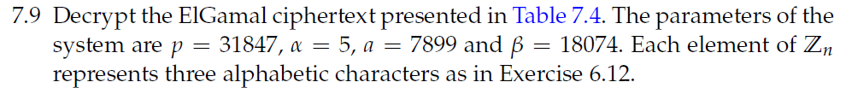
Homework 6:
Exercises: 7.1, 7.9(show the basic idea), 7.17, 7.23.
6.13

Slide 53

Thank you!
Questions?

